Slide 1
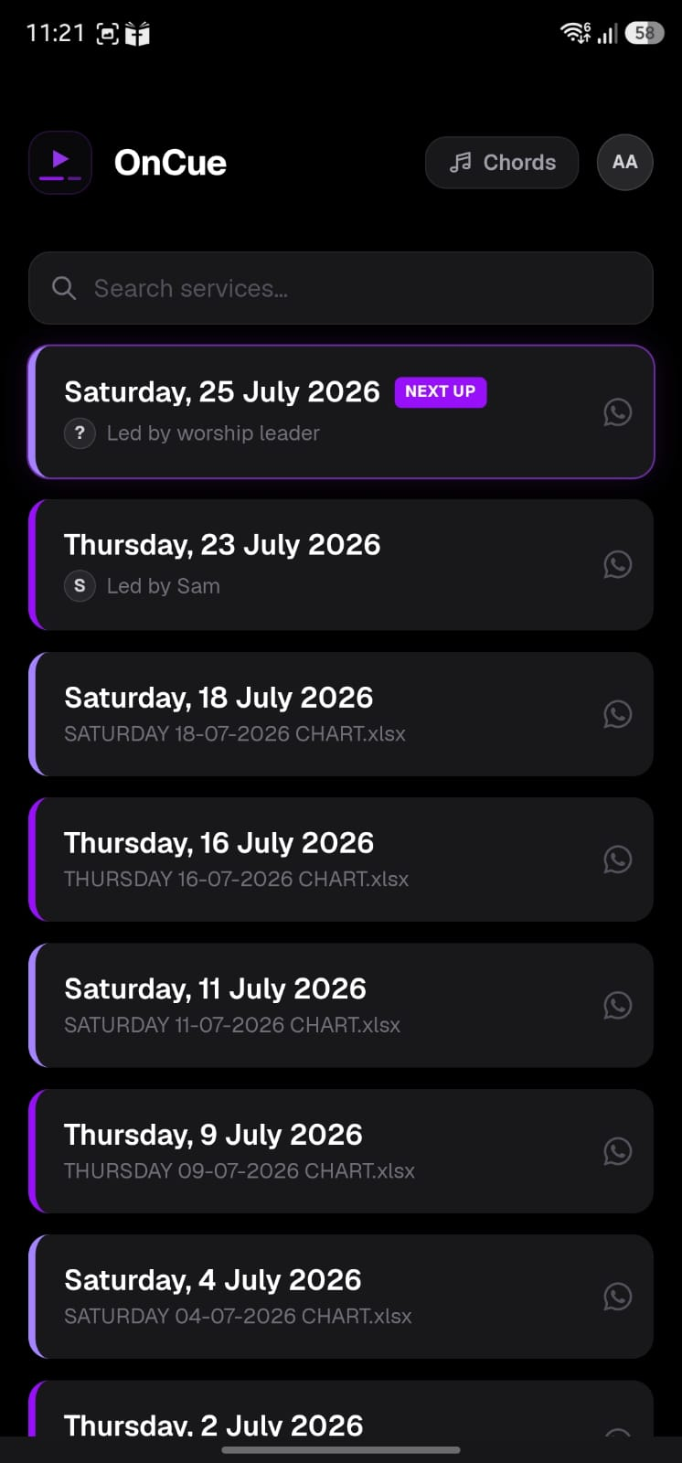
On the home page
Click on “Chords”

Slide 2
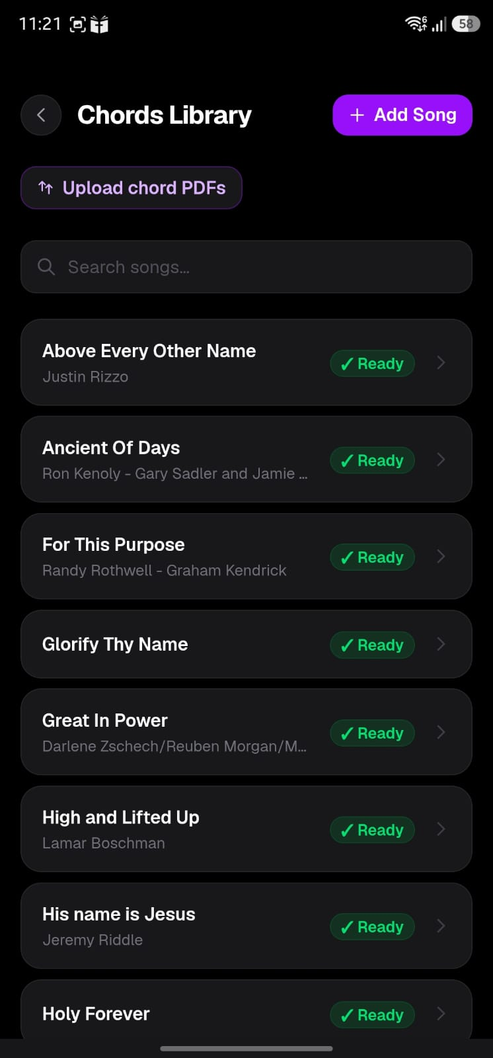
You have the whole list of uploaded songs here
You might have multiple versions of songs, hence Artist names

Slide 3
Here you select
“Upload chord
PDFs”
To upload from
your device

Slide 4
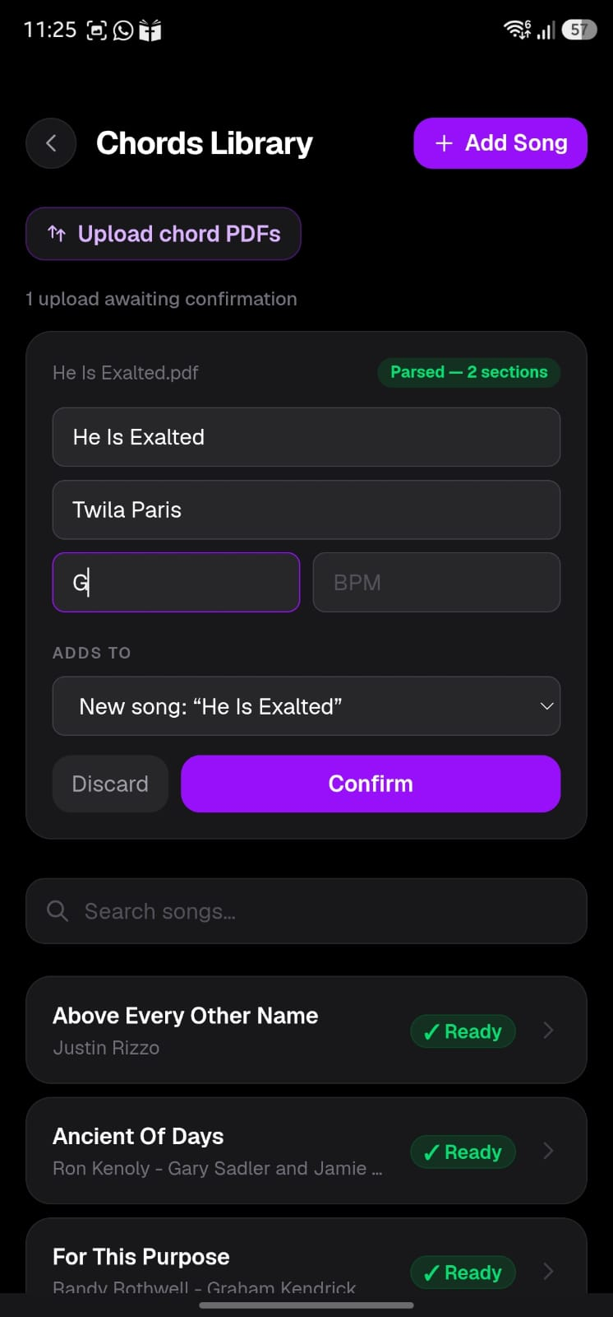
Once you’ve uploaded the PDF, you’ll fill song name, artist and most importantly, the Scale the chord sheet is in

Slide 5
Once you’ve uploaded the PDF, you’ll fill song name, artist and most importantly, the Scale the chord sheet is in
If another version of the song exists, it’ll be listed here instead of “New song..”

Slide 6
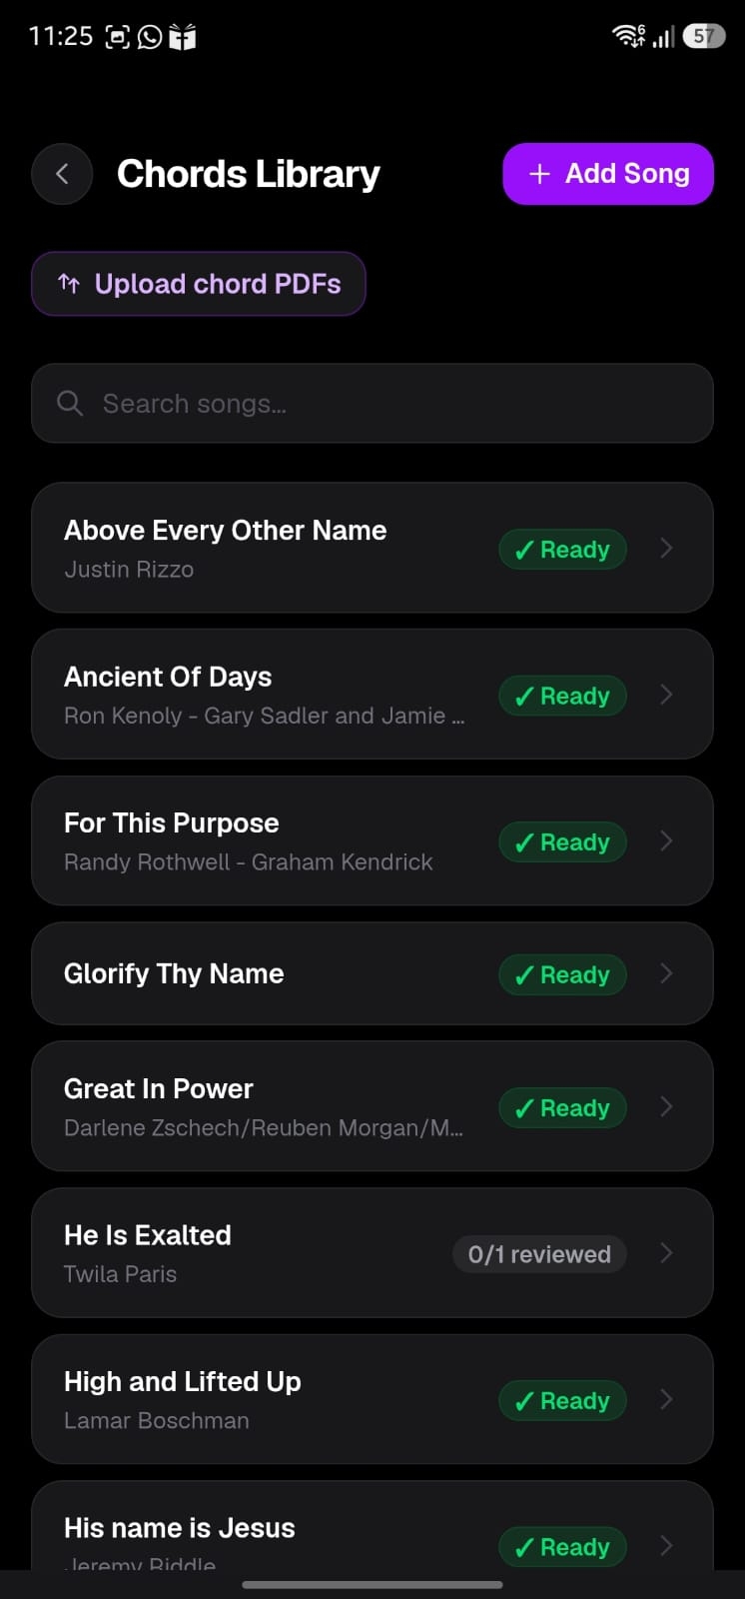
It takes a few seconds to load, or you may have to refresh, but eventually you’ll see the song listed here pending review
Click on the song

Slide 7
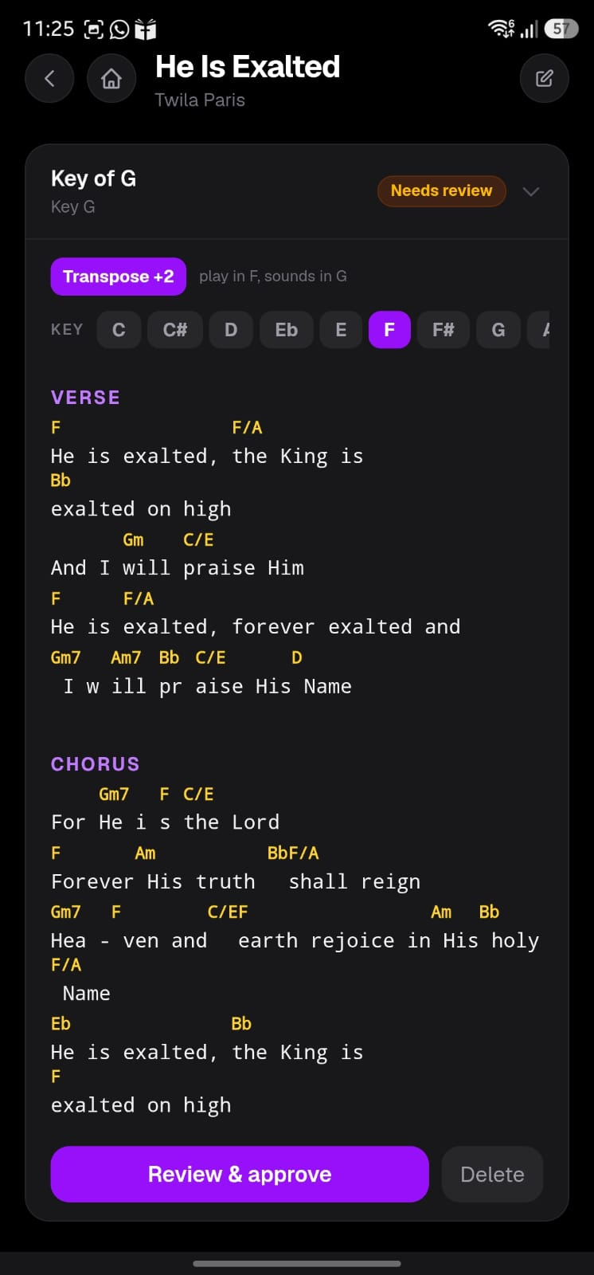
You can see the song here in your preferred key with the relevant “Transpose” or “Capo”
Here you click “Review & approve” to make changes

Slide 8
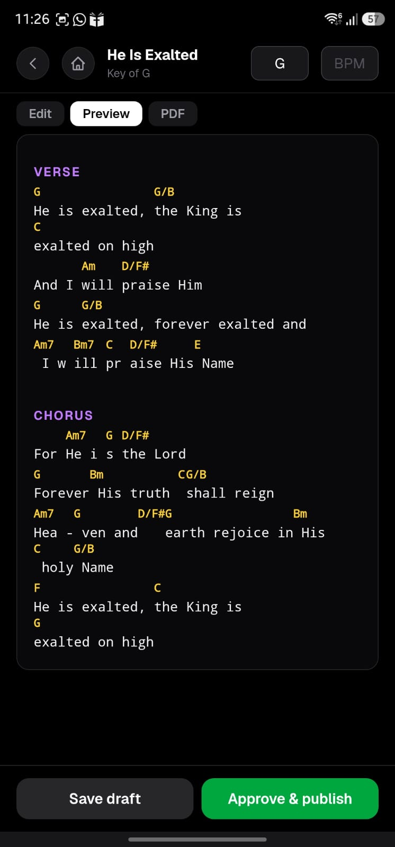
Click on edit

Slide 9
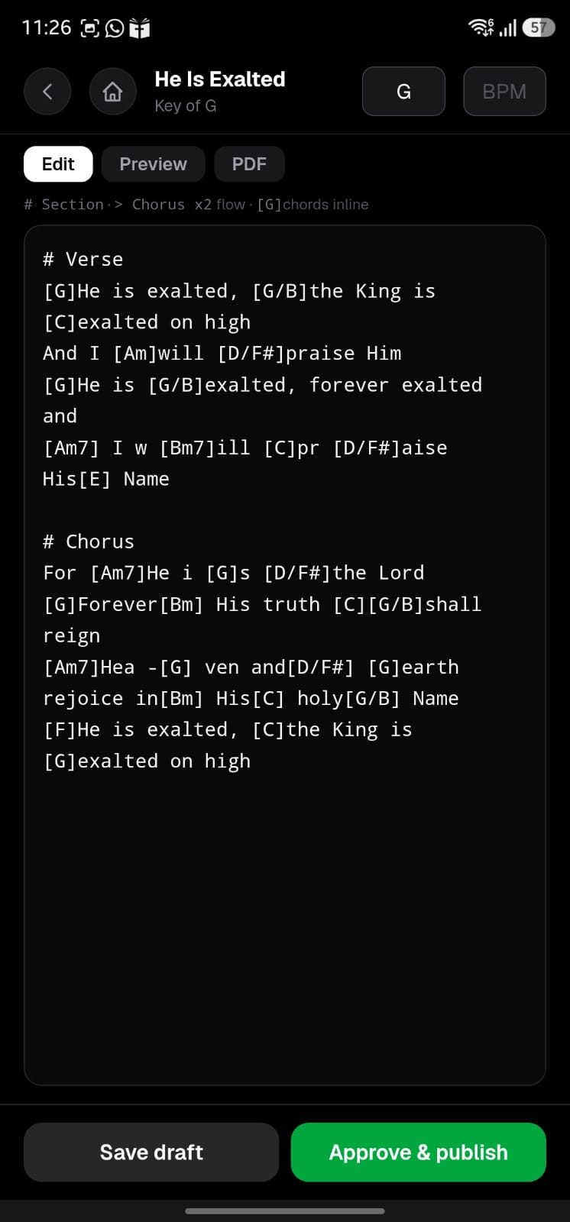
Here you will see how the chords are against the lyrics.
Here we can manually make changes to the chords, lyrics and arrangement
[..] square brackets are for chords
# is for sections
Sections are important because they map to the conductor notes

Slide 10
When we first upload, its common to see some errors, which have to be manually corrected

Slide 11
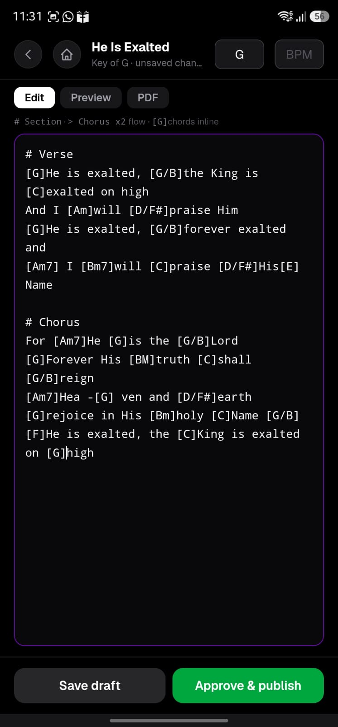
Once corrections are done, you can click “Approve & publish” to have the song chord go live

Slide 12
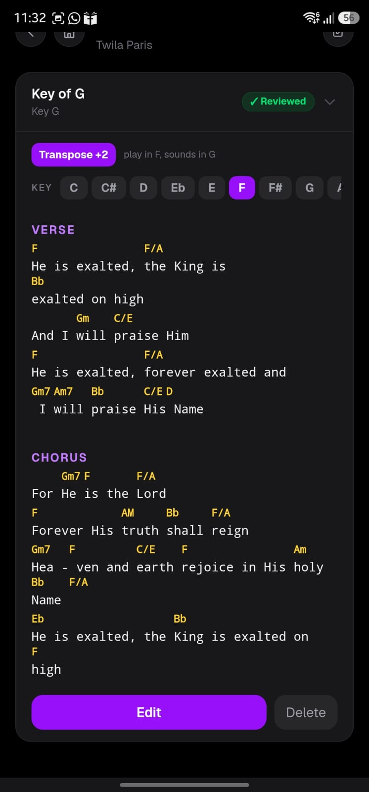
Done!

